Slide 1
Reversible Logic Gates

Slide 2
Topics:
Introduction
Types of Reversible logic
Principles of Reversible logic
Application of reversible logic
Advantages & Disadvantages of Reversible logic

Slide 3
Introduction
Reversible gates or Reversible logic gates are gates with a property of equal number of inputs and output,When the number of inputs and outputs are equal it will minimize energy loss during computation.

Slide 4
Types of Reversible logic
Toffoli Gate: A widely used reversible gate that performs a conditionalNOT operation
Fredkin Gate: A reversible gate that performs a controlled-swap operation.
Feynman Gate: A simple reversible gate that performs a controlled-NOT operation.
Peres Gate: A versatile reversible gate that combines Toffoli and Feynman gates.

Slide 5
Principles of Reversible Logic
Conservation of Information.​
Avoidance of Bit loss.​
Invertibility.​
Reversible Gates: NOT ,CNOT ,Toffoli ,Fredkin​

Slide 6
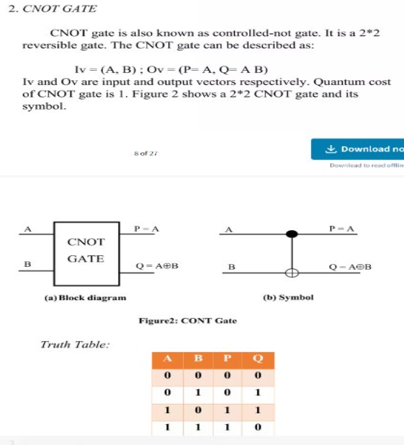
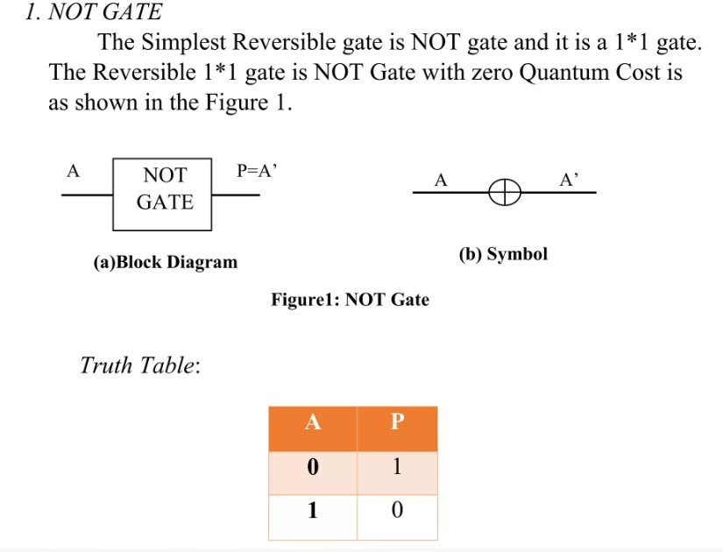
Examples:

Slide 7
Application of reversible logic
Quantum Computing.​
Low Power design.​
Cryptography and Security.​
Optical and Computing.​

Slide 8
Advantages:
Energy Efficiency
Quantum Computing
Reduced Heat Generation
Improved Circuit Density
Disadvantages:
Improved Circuit Density
Cost of Implementation
Limited Gate Options

